Slide 1





Slide 2
Open Contracting Data Standard
A brief background : What is Open Contracting?
Open contracting refers to norms and practices for increased disclosure and participation in public contracting including tendering, performance and completion.
Open contracting encompasses all public contracting, including contracts funded by combinations of public, private and donor sources.

Slide 3
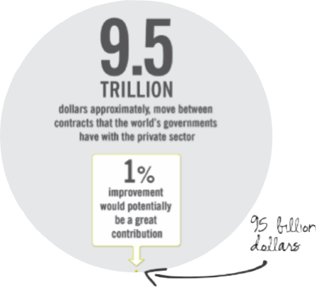
Open Contracting Data Standard
A brief background : Why Open Contracting?
In many countries around the world, public contracting has been identified as the government activity most vulnerable to wastefulness, mismanagement, inefficiency, and corruption.
Yet, contracting information is often unavailable to the public.

Slide 4
Open Contracting Data Standard
A brief background : Open Contracting Partnership
The Open Contracting Partnership (OCP) is a collaborative effort involving government and non-government actors with the aim of establishing a new norm of disclosure and broad participation in public contracting as a means to improve development outcomes.

Slide 5
Open Contracting Data Standard
A brief background on Open Contracting : Objectives
The objective of open contracting is to increase value for money for governments, to provide a fair and competitive business environment for the private sector, to increase aid effectiveness for donors, and to improve the quality of goods, works and services provided to citizens.

Slide 6
Open Contracting Data Standard
Open Contracting Partnership Work Streams
Global
Principles
Research and
Measurement
Implementation
and support
tools
Knowledge and
community
Data Standards
Advocacy
One of the main objectives of the OCP, among its multiple other work streams has been the establishment of a data standard for contracting information.

Slide 7
Open Contracting Data Standard
Why a data standard for Open Contracting?
The creation of a usable and flexible Open Contracting Data standard will ensure that:
there is a common understanding of what information should be shared, and at what stage of the contracting process;
contracting information from anywhere can be easily compared to other contracting and contracting-related information;
public bodies can easily adopt and implement a standard for sharing their contracting data, with a minimum of complexity; and
many different kinds of contracts can be described through simple extensions to the standard: from public procurement to revenue generating contracts, land contracts, extractives industry contracts, and public-private partnership contracts.

Slide 8
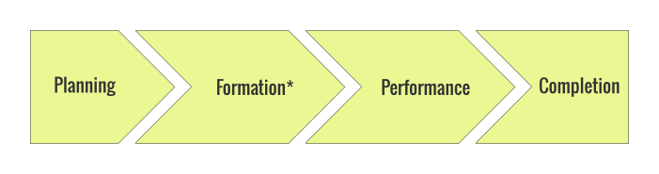
Open Contracting Data Standard
Contract Process
The contracting process is the sequence of stages related to the lifespan of a contract, beginning with planning and culminating in contract closure.
* Formation, when dealing with basic procurement processes, will often be referred to as Tendering & Award.

Slide 9
Open Contracting Data Standard
Data Model
For the beta of the Open Contracting Data Standard we have developed a JSON Schema rendering of a data model with an understanding this model can be easily serialized into other formats.
We have proposed an approach to map this data model into flat file CSV and DataPackage formats.
ref: http://ocds.open-contracting.org/standard/r/0__3__2/

Slide 10

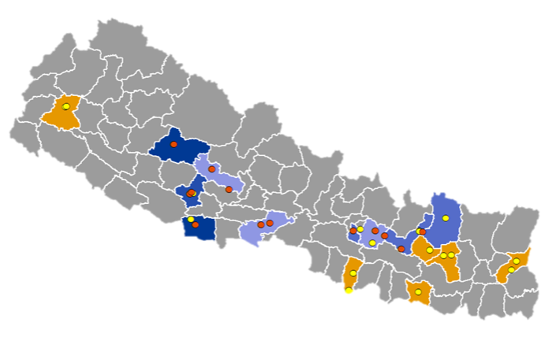
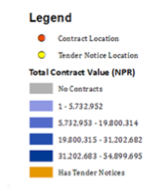
Use Case: Domestic and International Grants
Information on aid projects can be linked to details of the contracts that deliver those projects. With the detailed information on contracts one can get a better understanding of where donor spending is occurring and when. It also creates further opportunities for monitoring results.
Budgets/Aid
Contracts
Results /Delivery

Slide 11
Use Case: Meeting Federal financial and payment requirements for Treasury and OMB
Sec. 4(a)(2) of the Federal Funding Accountability and Transparency Act of 2006, as amended by DATA, which requires Treasury and OMB to establish government-wide "data elements for financial and payment information required to be reported by Federal agencies and entities receiving federal funds.” The OCDS provides fields in the standard that specifically addresses contract payment information.
Open Contracting Data Standard is a "international voluntary consensus standards bod(ies)” which is favoured by the new law.

Slide 12
Open Contracting Data Standard
What have we achieved so far?
Assessing data currently supplied through contract portals
Exploring demand for data on contracting
Building a Data Model that provides a high-level overview of the structure of the Data Standard used to describe the various stages of the contracting process.
Developing a Beta Version of the Standard that has been recently released for consultation. It provides a description of the overall Open Contracting Data Standard Model and a JSON Schema for open contracting releases and records that includes a set of recommended fields.

Slide 13
Open Contracting Data Standard
Next Steps
Conduct field visits to two countries (Mexico and Senegal)
Facilitate a dialogue among interested parties to collect their feedback on the Beta Version of the Standard.
Incorporate feedback and learnings from the field missions into new iterations of the Standard and develop the sector extensions for land and extractives.
Finalize Version 1.0 of the Standard and launch it during the Americas Regional Meeting of the Open Government Partnership (OGP) taking place in San José, Costa Rica on November 18, 2014.
Develop the governance model for the standard so that updates and changes are made based on the needs of all the relevant stakeholders, including publishers and users.
Identify, encourage and work closely with early adopters of the Standard.

Slide 14
Open Contracting Data Standard
To learn more and join the discussion:
Join our public mailing list:
https://groups.google.com/a/webfoundation.org/d/forum/public-ocds
See our efforts here:
http://www.open-contracting.org/
http://standard.open-contracting.org

Slide 15
Open Contracting Data Standard
About Us
The Open Contracting Partnership (OCP) is a multistakeholder partnership including GIZ, Oxfam, Integrity Action, Transparency International, The World Bank, Construction Sector Transparency Initiative, The Philippines Government Procurement Policy Board, and Colombia Compra Eficiente (National Public Procurement Agency of Colombia). One of the OCP workstreams is around Data Standards.
With support from The Omidyar Network and the World Bank, The Web Foundation’s Open Data team are working with OCP to prototype a Open Contracting Data Standard. The Web Foundation was set up in 2009 by Sir Tim Berners-Lee to create a world where everyone, everywhere can use the Web to communicate, collaborate and innovate freely.

